Slide 1

ICT502
Week 9: Project Evaluation and Reflection
ICT502 Applied IT Project A
1

Slide 2
What we learned last week
Introduction to IT Project Reports
Define Report Objectives and Scope
Understand Your Audience
Report Format and Type
Gather the Facts and Data
Structure the Report

Slide 3
Evaluating IT Projects in Real Industry
This week students learn:
- how IT projects are evaluated,
- how companies measure success,
- how stakeholder feedback improves projects,
- how to critically reflect on project outcomes,
- and how to apply lessons learned.
These ideas directly support Assessment 4.

Slide 4
Why Project Evaluation Matters
In Real Companies Like NSW IT Support:
Projects are not considered successful only because: ✔ the system works.
Projects must also: ✔ solve business problems ✔ improve customer experience ✔ reduce cost/time ✔ improve security ✔ satisfy stakeholders

Slide 5
Connecting Week 9 to Assessment 4
Assessment 4 Requires Students To Think About:
Evaluation
How will you know your solution works?
Stakeholder Feedback
What do users/clients think?

Slide 6
Connecting Week 9 to Assessment 4
Reflection
What could be improved later?
Future Development
How can the system evolve?

Slide 7
Common Problems NSW IT Support May Face
Possible Business Challenges
Challenge | Business Impact
Slow support response | unhappy clients
Cybersecurity incidents | security risks
Too many manual tasks | wasted staff time
Poor communication | client frustration
System downtime | business disruption
Managing many clients | operational complexity
Students should design solutions for realistic problems.

Slide 8
Questions Students Can Ask NSW IT Support
About Project Success
Useful Questions:
- How do you know if an IT solution is successful?
- What metrics/KPIs do you use?
- How do you measure customer satisfaction?
- How do you evaluate cybersecurity improvements?
- What problems still remain after implementation?

Slide 9
Questions About Stakeholder Feedback
Important Week 9 Questions
Students Can Ask:
- How do clients give feedback?
- What complaints are most common?
- How do engineers report project issues?
- How do you improve services after feedback?
- Do you conduct customer satisfaction surveys?
These questions help students write stronger evaluation and reflection sections.

Slide 10
Questions About Reflection & Lessons Learned
Reflection Questions
Students Can Ask:
- What are common mistakes in IT projects?
- Have any projects failed or faced delays?
- What lessons has the company learned?
- How has NSW IT Support improved over time?
- What would you do differently in future projects?

Slide 11
Helping Students Think Critically
Weak Thinking:
“The project was successful because the system worked.”
X Too simple
Better Thinking:
“The project improved ticket response time, reduced manual workload, and increased customer satisfaction.”
- measurable - business-focused - evaluative

Slide 12
Example: Evaluation for Assessment 4
Proposed Project:
AI-based Ticketing System
How Students Can Evaluate Success
Metrics:
- reduced ticket response time
- fewer unresolved tickets
- improved customer satisfaction
- reduced manual ticket sorting
- improved operational efficiency

Slide 13
Quantitative Evaluation Examples
Students Can Measure:
This supports ROI and cost-benefit analysis.
Metric | Example
Response time | 40% faster
Ticket resolution | fewer pending tickets
Cost savings | reduced staff workload
Downtime reduction | improved reliability

Slide 14
Qualitative Evaluation Examples
Students Can Gather:
Client Feedback
- easier communication
- better support experience
Staff Feedback
- reduced workload
- easier system management

Slide 15
Qualitative Evaluation Examples
Management Feedback
- improved efficiency
- better reporting

Slide 16
Example Stakeholder Analysis
Stakeholder | Interest
Clients | fast support
Engineers | easier workflow
Managers | lower cost
Security teams | better protection
Students can include this in Assessment 4.

Slide 17
Example Challenges & Student Solutions
NSW IT Support Challenge | Possible Student Solution
repetitive support tickets | AI chatbot
security monitoring difficulty | cybersecurity dashboard
client communication delays | customer portal
manual reporting | automated analytics dashboard
remote support issues | cloud-based support system

Slide 18
Critical Reflection Questions for Students
Students Should Reflect:
- What worked well in our project?
- What challenges did we face?
- Was our solution realistic?
- What would we improve?
- Did we communicate effectively?
- Did our project meet stakeholder needs?
This strengthens Section 6 of Assessment 4.

Slide 19
Integrating Evaluation into Project Management
Students Should Explain:
Before Implementation
- feasibility analysis
- stakeholder analysis
During Implementation
- progress monitoring
- testing

Slide 20
Integrating Evaluation into Project Management
After Implementation
- evaluation
- client feedback
- future improvements

Slide 21
Example Future Development Ideas
Example:
AI Ticketing System
Future Improvements:
- voice AI support
- predictive analytics
- mobile app integration
- multilingual chatbot
- automated cybersecurity alerts
Helps students write stronger “Future Development” sections.

Slide 22
Questions About Future Technology
Students Can Ask:
- What technologies do you plan to adopt in future?
- Is AI becoming more important?
- How important is cloud computing now?
- What cybersecurity trends concern your company most?

Slide 23
Australian Context (Very Important)
Students Should Think About Australian IT Challenges:
- cybersecurity attacks on businesses
- privacy and data protection
- remote work/cloud security
- SMEs needing affordable IT solutions
- rising AI and automation adoption
Makes projects more realistic and industry-relevant.

Slide 24
Australian Industry-Focused Questions
Students Can Ask:
- What cybersecurity concerns are most common for Australian SMEs?
- How do Australian privacy regulations affect your projects?
- Do clients prefer cloud or on-premise systems?
- How has remote work changed client needs?
- Are AI solutions becoming more common in Australia?

Slide 25
Professional Communication Tips
When Speaking to NSW IT Support
- ask business-focused questions - ask WHY decisions are made - ask about challenges and improvements - take notes professionally - connect answers to Assessment 4

Slide 26
Example Assessment 4 Paragraph
Example
NSW IT Support identified slow ticket handling and repetitive support requests as common operational challenges. To address this issue, the proposed solution introduces an AI-assisted ticket classification system that automatically prioritises support requests. The project’s success can be evaluated through reduced response time, improved client satisfaction, and lower manual workload for engineers.

Slide 27
Example Assessment 4 Paragraph
This shows:
- problem - evidence - solution - evaluation

Slide 28
Final Advice for Students
High-Quality Assessment 4 Reports:
- solve realistic business problems - evaluate project success clearly - include stakeholder feedback - discuss lessons learned - propose future improvements - connect technology to business value

Slide 29
Final Message
Think Like a Real IT Consultant
Ask yourself:
- Did my solution improve the business?
- How would the company measure success?
- What feedback would users give?
- What could be improved later?
- Is my project realistic in Australia’s IT industry?

Slide 30
VERY STRONG OPTIONAL ACTIVITY
Mini Evaluation Workshop
Task:
Students choose:
- one business challenge,
- one proposed solution,
- three evaluation metrics,
- and one future improvement idea.
This would help them directly prepare for Assessment 4.

Slide 31
Week 9 Pre-Class Readings
Watch the Video in 10 minutes - YouTube Video:
Types of Project Evaluation Methods
https://www.youtube.com/watch?v=mURStfl3Igg&list=PLJBzV_AsRENMOTklGQ2jhzkvjckCQMjaU

Slide 32
Week 9 Pre-Class Readings
Key messages from the video: Project Evaluation Methods
1. Every project needs evaluation
A project should not finish without checking whether it was successful. Evaluation helps us understand if the project achieved its goals.

Slide 33
Week 9 Pre-Class Readings
2. Evaluation means checking the value of a project
Evaluation is a detailed review of a project. It answers questions like:
- Did the project work?
- Did it solve the problem?
- Was it worth the time and money?
- What changed because of the project?

Slide 34
Week 9 Pre-Class Readings
3. Evaluation helps us learn
The main purpose of evaluation is not only to judge success or failure. It helps the team learn what went well and what needs improvement.

Slide 35
Week 9 Pre-Class Readings
4. Projects can create positive or negative change
A project may improve a situation, but it may also create new problems. Evaluation helps identify both good and bad results.

Slide 36
Week 9 Pre-Class Readings
5. Monitoring and evaluation are different
Monitoring | Evaluation
Tracks progress | Judges success
Happens regularly | Happens at important stages or end
Focuses on activities | Focuses on outcomes and impact
Asks “what is happening?” | Asks “why did it happen?”

Slide 37
Week 9 Pre-Class Readings
6. Evaluation checks important areas
Evaluation may measure:
- effectiveness → did the project achieve its goals?
- efficiency → were resources used well?
- sustainability → can the results continue in future?
- impact → what changed because of the project?
- value for money → was the project worth the cost?

Slide 38
Week 9 Pre-Class Readings
7. Evaluation improves future projects
Teams can learn from mistakes and improve future projects by using lessons learned from evaluation.

Slide 39
Week 9 Pre-Class Readings
8. Different evaluation methods exist
The video introduces several methods such as:
- process evaluation
- impact evaluation
- case study
- rapid appraisal
- pre-implementation assessment
Different projects may use different evaluation methods.

Slide 40
Week 9 Pre-Class Readings
9. Important lesson for IT students
In IT projects, success is not only:
“The system works.”
Real success means:
- users are satisfied,
- business problems are solved,
- systems improve efficiency,
- and the organisation benefits.

Slide 41
Discussion Questions for Students
Why is project evaluation important?
Project evaluation helps us understand whether the project achieved its goals and solved the intended problem.

Slide 42
Discussion Questions for Students
2. What is the difference between monitoring and evaluation?
Monitoring tracks project progress regularly, while evaluation checks the final results and overall success of the project.

Slide 43
Discussion Questions for Students
3. What are some things evaluation can measure?
Evaluation can measure effectiveness, efficiency, impact, sustainability, and value for money.

Slide 44
Discussion Questions for Students
4. Why is learning from mistakes important in projects?
Learning from mistakes helps teams improve future projects and avoid repeating the same problems.

Slide 45
Discussion Questions for Students
5. Can a project have negative impacts?
Yes. Some projects may create unexpected problems or challenges, so evaluation helps identify both positive and negative effects.

Slide 46
Discussion Questions for Students
6. How can evaluation help NSW IT Support?
Evaluation can help NSW IT Support understand if their IT solutions improve customer service, reduce delays, and solve client problems effectively.

Slide 47
Discussion Questions for Students
7. In an IT project, is a working system enough to call the project successful? Why or why not?
No. A project is successful only if it also improves business performance, satisfies users, and solves real problems.

Slide 48
Week 9 Topics
Methods of Project Evaluation
Critical Reflection on Project Performance
Integration of Evaluation into Project Management
Impact Assessment and Stakeholder Feedback
Incorporating Lessons Learned into Future Projects

Slide 49
Pre-Class Discussion
YouTube Video:
Watch the Video in 10 minutes - What is Evaluation? Understanding the Project Evaluation Methods
https://www.youtube.com/watch?v=uCUsj7_vAcI

Slide 50
Pre-Class Discussion
1. Evaluation is important in every project
Every project should be evaluated to understand:
- what worked well,
- what problems happened,
- and how future projects can improve.
Evaluation is not something to fear. It is a way to learn and improve.

Slide 51
Pre-Class Discussion
2. Evaluation helps organisations improve
Companies and project teams use evaluation to:
- identify challenges,
- improve project quality,
- make better decisions,
- and increase project success in future.

Slide 52
Pre-Class Discussion
3. There are different types of project evaluation
The video explains three important evaluation methods:
Process Evaluation
Outcome Evaluation
Impact Evaluation
Each one focuses on a different part of the project.

Slide 53
Pre-Class Discussion
Process Evaluation
What is it?
Process evaluation checks:
- whether project activities are done correctly,
- whether tasks follow the right procedures,
- and whether work is completed on time.

Slide 54
Pre-Class Discussion
Simple Example
Building a house:
- buying materials,
- hiring workers,
- managing construction,
- following quality standards.

Slide 55
Pre-Class Discussion
These are all processes.
Main lesson:
Process evaluation focuses on: - activities - procedures - quality - timelines

Slide 56
Pre-Class Discussion
Outcome Evaluation
What is it?
Outcome evaluation measures the short- to medium-term results of a project.

Slide 57
Pre-Class Discussion
Simple Example
If a person builds a rental house:
- they may earn more income,
- save money,
- or improve financial stability.
These are outcomes.

Slide 58
Pre-Class Discussion
Main lesson:
Outcome evaluation focuses on: - short-term changes - benefits achieved - project results

Slide 59
Pre-Class Discussion
Impact Evaluation
What is it?
Impact evaluation measures the long-term effects of a project.

Slide 60
Pre-Class Discussion
Simple Example
Over many years, the extra income from the rental house may improve:
- health,
- education,
- nutrition,
- family wellbeing,
- and overall quality of life.

Slide 61
Pre-Class Discussion
These are long-term impacts.
Main lesson:
Impact evaluation focuses on: - long-term change - broader social/business impact - sustainable improvement

Slide 62
Pre-Class Discussion
4. Process, Outcome, and Impact are connected
Evaluation Type | Focus
Process | How the project was done
Outcome | Short/medium-term results
Impact | Long-term change

Slide 63
Pre-Class Discussion
5. Formative and Summative Evaluation
Formative Evaluation
- happens during the project,
- focuses on improvement,
- checks whether activities are going as planned.
“Are we doing things correctly?”

Slide 64
Pre-Class Discussion
Summative Evaluation
- happens after the project,
- focuses on final results,
- measures what was achieved.
“Did the project succeed?”

Slide 65
Pre-Class Discussion
6. Evaluation supports learning
The video explains that evaluation helps teams:
- learn from mistakes,
- improve future projects,
- and make better project decisions.

Slide 66
Pre-Class Discussion
7. Main lesson for IT students
For Assessment 4, students should not only explain:
“What system they built.”
They should also explain:
- how success will be measured,
- what improvements the project creates,
- what short-term and long-term benefits may happen,
- and how the company can evaluate project performance.

Slide 67
Discussion Questions for Students
Why is project evaluation important?
Project evaluation helps organisations understand whether the project achieved its goals and what improvements are needed in future.

Slide 68
Discussion Questions for Students
2. What does process evaluation focus on?
Process evaluation focuses on project activities, procedures, quality, and whether tasks are completed correctly and on time.

Slide 69
Discussion Questions for Students
3. What is the difference between outcome and impact evaluation?
Outcome evaluation measures short-term results, while impact evaluation measures long-term changes and effects.

Slide 70
Discussion Questions for Students
4. Give an example of an outcome from an IT project.
An example could be faster customer support response time after introducing a new ticketing system.

Slide 71
Discussion Questions for Students
5. Give an example of an impact from an IT project.
A long-term impact could be improved customer satisfaction and business growth over several years.

Slide 72
Discussion Questions for Students
6. What is formative evaluation?
Formative evaluation happens during the project and helps teams improve while the project is still running.

Slide 73
Discussion Questions for Students
7. What is summative evaluation?
Summative evaluation happens after the project and measures the final success and results.

Slide 74
Discussion Questions for Students
8. How can NSW IT Support use project evaluation?
NSW IT Support can use evaluation to check whether their IT solutions improve customer service, reduce delays, improve cybersecurity, and increase client satisfaction.

Slide 75
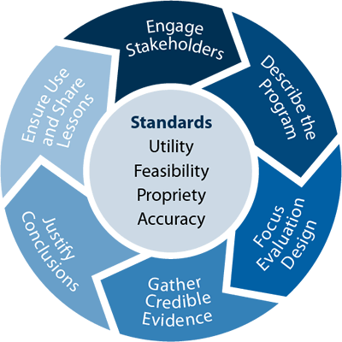
Methods of IT Project Evaluation
Overview of Project Evaluation in IT:
Project evaluation in IT focuses on assessing the effectiveness, efficiency, and success of IT initiatives, such as software development, system upgrades, or infrastructure enhancements.
Importance of evaluating IT projects to ensure alignment with organisational goals, budget adherence, and stakeholder satisfaction.

Slide 76
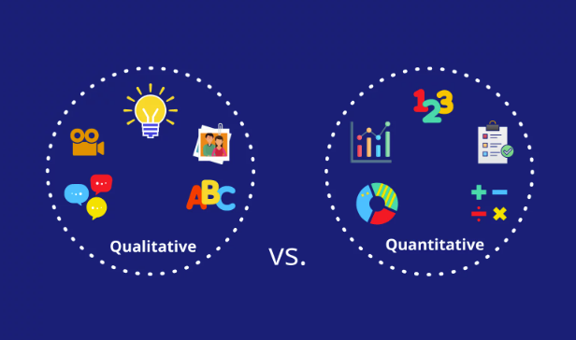
Methods of IT Project Evaluation

Slide 77
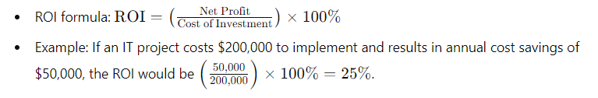
Methods of IT Project Evaluation: Quantitative Methods
Quantitative Methods:
1) ROI (Return on Investment):
Measures the financial return generated relative to the investment made in the IT project.
Example: Calculating ROI for a cloud migration project by comparing cost savings and operational efficiencies achieved.

Slide 78
Methods of IT Project Evaluation: Quantitative Methods(cont.)
2) Cost-Benefit Analysis:
Evaluates the financial viability of the IT project by comparing costs with expected benefits.
Steps in conducting cost-benefit analysis for IT projects:
Identifying and estimating all costs associated with the project (development, implementation, maintenance).
Quantifying and valuing the benefits expected from the project (reduced operational costs, increased productivity).
Comparing costs and benefits to determine the financial feasibility and expected return on investment.

Slide 79
Methods of IT Project Evaluation: Qualitative Evaluation Methods
Qualitative Data Collection
1) Interviews:
Purpose: To gather in-depth insights and detailed feedback from individual stakeholders regarding their experiences and perceptions of the IT project.
Types of Interviews:
Structured Interviews: Using a fixed set of questions to ensure consistency across different interviewees.
Semi-Structured Interviews: Allowing flexibility in questions to explore specific issues in more depth.

Slide 80
Methods o f IT Project Evaluation: Qualitative Evaluation Methods
2) Surveys
Purpose: To collect quantifiable data from a larger group of stakeholders to assess overall satisfaction and identify common issues.
Types of Surveys:
Online Surveys: Distributed via email or web platforms for convenience and broad reach.
Paper Surveys: Used in environments where digital access is limited.

Slide 81
Methods o f IT Project Evaluation: Qualitative Evaluation Methods
3) Focus Groups:
Purpose: To facilitate group discussions that provide diverse perspectives and encourage interactive dialogue among participants.
Types of Focus Groups:
User Focus Groups: Engaging users from different departments to discuss their experiences with a new IT system.
Expert Focus Groups: Gathering IT experts to evaluate the technical aspects and potential improvements for an ongoing IT project.

Slide 82
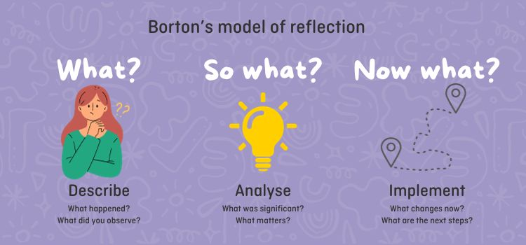
Critical Reflection on Project Performance

Slide 83
Critical Reflection on Project Performance： Introduction
Introduction to Critical Reflection in IT Projects
Definition and Importance:
Critical Reflection: The process of thoughtfully considering and analysing an IT project’s performance to identify strengths, weaknesses, and areas for improvement.
Purpose: To enhance learning and growth by examining what worked well and what didn’t, leading to better future project outcomes.
Importance in IT Projects: Given the complexity and dynamic nature of IT projects, critical reflection helps in adapting to technological changes, improving methodologies, and increasing overall project success.

Slide 84
Critical Reflection on Project Performance: Benefits
Benefits of Critical Reflection:
Improved Decision-Making: Helps in making informed decisions based on past experiences and lessons learned.
Enhanced Team Collaboration: Fosters an environment of continuous learning and open communication among team members.
Identification of Best Practices: Allows the organisation to document and replicate successful strategies in future projects.
Risk Management: Aids in identifying potential risks early and developing mitigation strategies.

Slide 85
Critical Reflection on Project Performance: Methods
1) After-Action Review (AAR):
Process: A structured review or debrief process for analysing what happened, why it happened, and how it can be done better.
Steps:
What was expected to happen?
What actually happened?
Why was there a difference?
What can we learn from this?

Slide 86
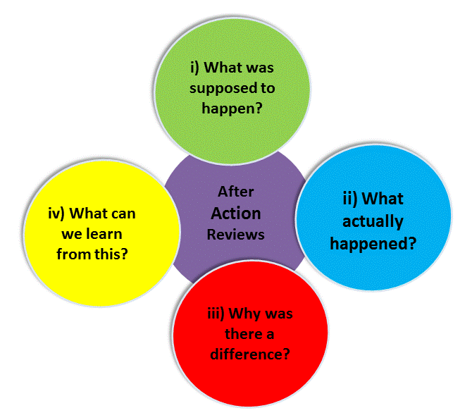
Critical Reflection on Project Performance: Methods (cont.)
After-Action Review (AAR):

Slide 87
Critical Reflection on Project Performance: Methods (cont.)
2) SWOT Analysis:
Purpose: Identifies the Strengths, Weaknesses, Opportunities, and Threats related to the IT project.
Steps:
Strengths: What did the team do well? What resources and capabilities were effectively utilised?
Weaknesses: What could have been improved? What obstacles were encountered?
Opportunities: What opportunities were identified during the project? How can they be leveraged in the future?
Threats: What risks emerged? How can they be mitigated in future projects?

Slide 88
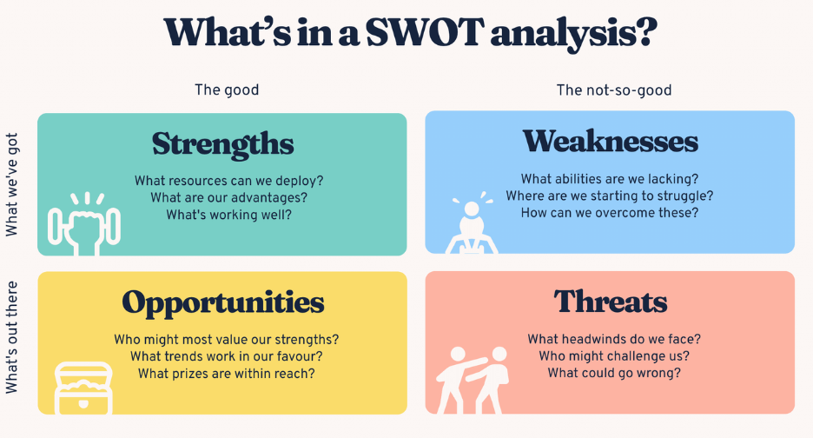
Critical Reflection on Project Performance: Methods (cont.)

Slide 89
Critical Reflection on Project Performance: Implementing
Creating a Reflective Culture:
Encouraging Open Communication:
Promote a culture where team members feel comfortable sharing their thoughts and feedback.
Regular team meetings and open forums for discussing project progress and challenges.
Documentation and Knowledge Sharing:
Maintain detailed records of reflections, lessons learned, and best practices.
Use knowledge management systems to store and share these documents across the organisation.

Slide 90
Critical Reflection on Project Performance: Implementing
Practical Steps for Integrating Reflection:
Scheduled Reflection Sessions:
Plan regular reflection sessions at key project milestones (e.g., post-planning, mid-project, post-implementation).
Feedback Mechanisms:
Implement anonymous surveys and feedback forms to gather honest input from team members.
Use project management tools to track feedback and action items.
Action Plans:
Develop action plans based on reflection outcomes to address identified issues and leverage strengths.
Assign responsibilities and timelines to ensure that reflective insights lead to concrete improvements.

Slide 91
Integration of Evaluation into Project Management
Incorporating Evaluation into the Project Lifecycle
Definition: Embedding systematic assessments throughout the project lifecycle.
Purpose: Align activities with objectives, use resources efficiently, and meet stakeholder expectations.
Evaluation Phases:
Initiation Phase:
Feasibility Studies: Assess project viability, risks, and benefits.
Stakeholder Analysis: Evaluate stakeholder needs and impacts.
Planning Phase:
Defining Metrics: Establish criteria for project success.
Baseline Assessments: Capture initial conditions and set benchmarks.
Execution Phase:
Continuous Monitoring: Track progress against plans.
Mid-Project Reviews: Conduct reviews at key milestones.

Slide 92
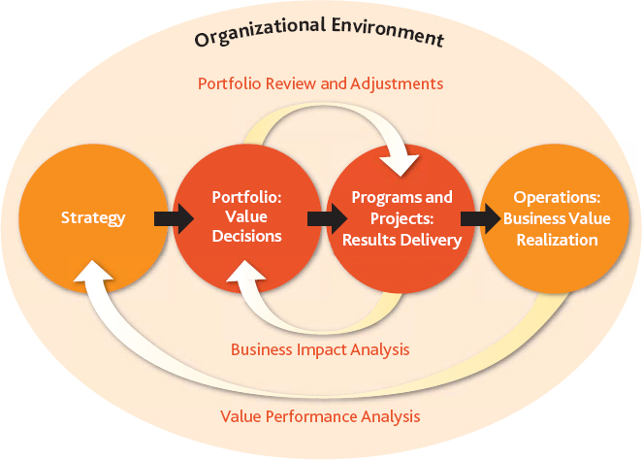
Impact Assessment and Stakeholder Feedback

Slide 93
Impact Assessment and Stakeholder Feedback
Importance of Impact Assessment:
Definition: Impact assessment involves evaluating the effects of an IT project on various aspects such as business processes, user experience, and organisational goals.
Purpose: Helps identify positive outcomes and potential drawbacks of the project.
Benefits:
Informs decision-making for future projects.
Provides insights into project success and areas for improvement.

Slide 94
Impact Assessment and Stakeholder Feedback (cont.)
Conducting an Impact Assessment:
Key Steps: Define Metrics: Establish criteria for measuring project impact (e.g., efficiency gains, user satisfaction, cost savings).
Collect Data: Gather quantitative and qualitative data through surveys, interviews, and performance analytics.
Analyse Results: Compare pre- and post-implementation data to assess changes and impacts.
Report Findings: Summarise the assessment in a clear, structured report highlighting key insights and recommendations.

Slide 95
Impact Assessment and Stakeholder Feedback (cont.)
Stakeholder Feedback:
Definition: Stakeholder feedback involves gathering input from those affected by or involved in the project.
Gathering Stakeholder Feedback:
Methods:
Surveys and Questionnaires: Efficient way to collect feedback from a large number of stakeholders.
Interviews and Focus Groups: Provides in-depth insights and allows for interactive discussions.
Feedback Forms: Simple and accessible means for stakeholders to provide input.
Key Considerations:
Anonymity: Ensure confidentiality to encourage honest feedback.
Relevance: Tailor questions to gather specific, actionable insights.
Follow-Up: Address feedback received and inform stakeholders of any actions taken as a result.

Slide 96
Incorporating Lessons Learned into Future Projects
Documenting Lessons Learned:
Collection Methods:
Post-Project Reviews: Conduct formal meetings at the end of the project to gather team feedback.
Surveys and Questionnaires: Collect input from team members and stakeholders about their experiences.
Project Logs and Reports: Review documentation for issues and successes noted during the project.
Key Areas to Document:
Project Planning: What planning steps were successful or need improvement?
Execution: Which processes and methods worked well or caused problems?
Team Performance: How did the team dynamics and collaboration impact the project?
Stakeholder Engagement: What were the successes and challenges in stakeholder communication and involvement?

Slide 97
Group Discussion Case Study
Scenario: Implementation of a Hospital Management System
You are the project manager for a team tasked with implementing a new Hospital Management System (HMS) at a regional hospital. The project aimed to replace the outdated system with a more efficient and user-friendly software that integrates patient records, appointment scheduling, billing, and inventory management. The project has recently been completed, and you are now in the phase of evaluating the project and reflecting on its outcomes.
Questions:
What are the main objectives of the Hospital Management System project?
What methods you can use to evaluate the success of the project?
How stakeholder feedback influences the project's outcomes?

Slide 98
Case Study: Discussion Points
What are the main objectives of the Hospital Management System project?
Improve Efficiency: Streamline hospital operations by integrating various functions (patient records, scheduling, billing, inventory).
Enhance User Experience: Provide a more user-friendly interface for hospital staff and patients.
Data Accuracy: Ensure accurate and up-to-date patient information.
Compliance: Ensure the system meets healthcare regulations and standards.
Cost Reduction: Reduce operational costs through automation and improved resource management.

Slide 99
Case Study: Discussion Points
2. What methods you can use to evaluate the success of the project?
Performance Metrics: Track key performance indicators (KPIs) such as system uptime, processing speed, and user satisfaction.
User Surveys: Collect feedback from hospital staff and patients regarding their experience with the new system.
Audit Reports: Conduct audits to ensure compliance with healthcare standards and regulations.
Operational Reports: Analyse data on appointment scheduling, billing accuracy, and inventory management efficiency.
Stakeholder Meetings: Hold review meetings with stakeholders to discuss project outcomes and gather feedback.

Slide 100
Case Study: Discussion Points
3.How stakeholder feedback influences the project's outcomes?
User Feedback: Input from hospital staff led to modifications in the user interface to make it more intuitive.
Patient Feedback: Feedback from patients resulted in improved appointment scheduling features.
Management Feedback: Insights from hospital management helped prioritise features that improved operational efficiency and compliance

Slide 101
Summary
Techniques for assessing project outcomes and performance effectively.
Analysed successes and challenges to improve future project management.
Highlighted the importance of embedding evaluation processes for continuous improvement.
Emphasised gathering stakeholder perspectives to refine strategies and assess project impact.
Stressed applying insights from past projects to enhance future planning and execution.
Underlined ongoing evaluation and reflection as essential for achieving and sustaining project success.

Slide 102
Q&A
Question?

